Slide 1
Particle Interactions

Slide 2
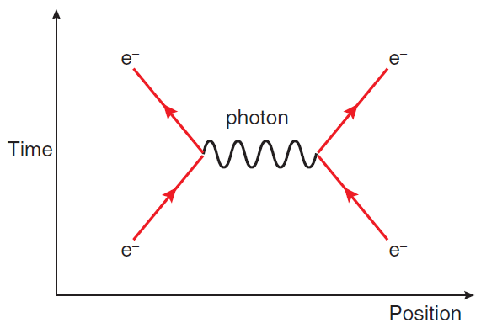
Representing Particle Interactions
The Standard Model describes a large number of particles that can interact in a wide variety of ways. In 1948, American physicist Richard Feynman devised a type of simple diagram that can be used to represent these interactions.
In these Feynman diagrams:
there are two graph-like axes: position and time (usually x and y respectively, but always check!). Only one dimension of space is considered, which is enough to describe particles coming together or moving apart.
matter particles are represented by solid lines with arrows pointing forward through time; antimatter particles have arrows pointing backwards through time.
gauge bosons are represented by squiggly lines (though sometimes other lines are used – always read any labels carefully).
Notes:
Note that Feynman diagrams aren’t explicitly mentioned by the syllabus, but they’re so helpful for understanding this topic that I’ve included them anyway.
Position is technically optional, as you can see in Example #1.
W and Z bosons should get dashed lines, and gluons usually get these curly spring-like lines, but this is not always respected.

Slide 3
Representing Particle Interactions
Feynman diagrams should always be read from the bottom (t = 0) up. In this diagram:
two electrons (solid lines pointing forward through time: ordinary matter)
approach each other (lines are converging)
interact via the electromagnetic force (carried by the photon)
and begin to move apart (lines are diverging)
So this diagram is depicting the repulsion of like charges.
Note that this photon does not exist outside of the interaction – only two electrons enter, and only two electrons leave. The photon cannot be directly observed.
Notes:
This makes the photon a virtual particle. The other gauge bosons behave like this pretty much all the time; photons are unusual in that they also commonly exist as real particles.

Slide 4
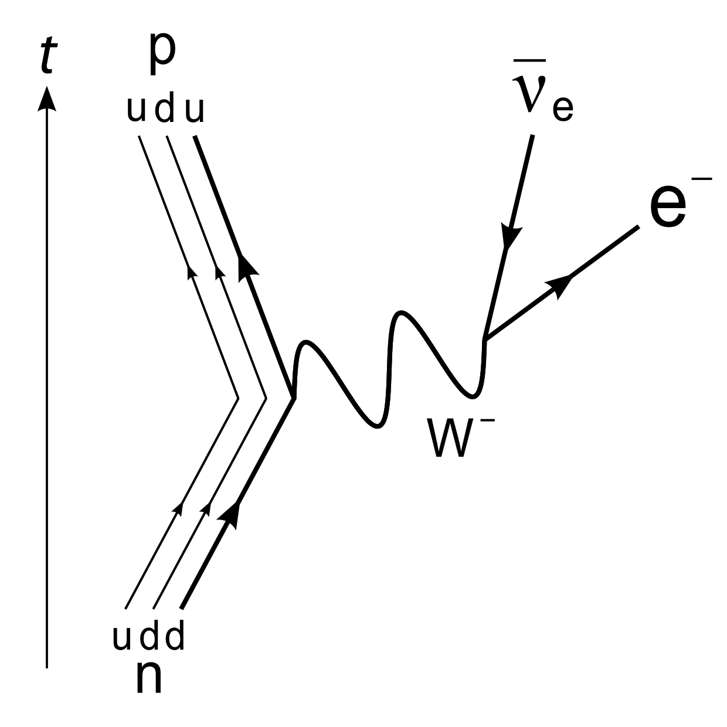
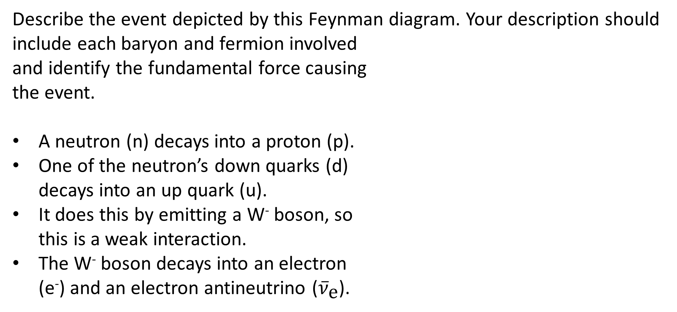
Example #1
Describe the event depicted by this Feynman diagram. Your description should include each baryon and fermion involved and identify the fundamental force causing the event.
A neutron (n) decays into a proton (p).
One of the neutron’s down quarks (d) decays into an up quark (u).
It does this by emitting a W⁻ boson, so this is a weak interaction.
The W⁻ boson decays into an electron (e⁻) and an electron antineutrino (${\overline{ν}}_{\text{e}}$).
Notes:
Note that position is less relevant here – the bend represents the interaction itself, not a change in direction.
This is β⁻ decay.

Slide 5
Rules of Particle Interactions
There are a number of laws that govern particle interactions and composition.
Conservation of electric charge: the total charge of the particles that enter an interaction must always equal the total charge of the particles that emerge. (Note that composite particles must have integer charges.)
Baryon number: the combined baryon numbers of the quarks in a hadron must be equal to 1 (for baryons), 0 (for mesons), or -1 (for antibaryons).
Conservation of baryon number: like charge, the total baryon number must be the same before and after an interaction.
Conservation of lepton numbers: each family of leptons (electrons, muons, and taus, each including their neutrinos) has their own lepton number (L_{e}, L_{μ}, and L_{τ}) that must be separately conserved.
Baryon and lepton numbers can be found on your formula sheet.
Note that antiparticles have negative baryon / lepton numbers.

Slide 6
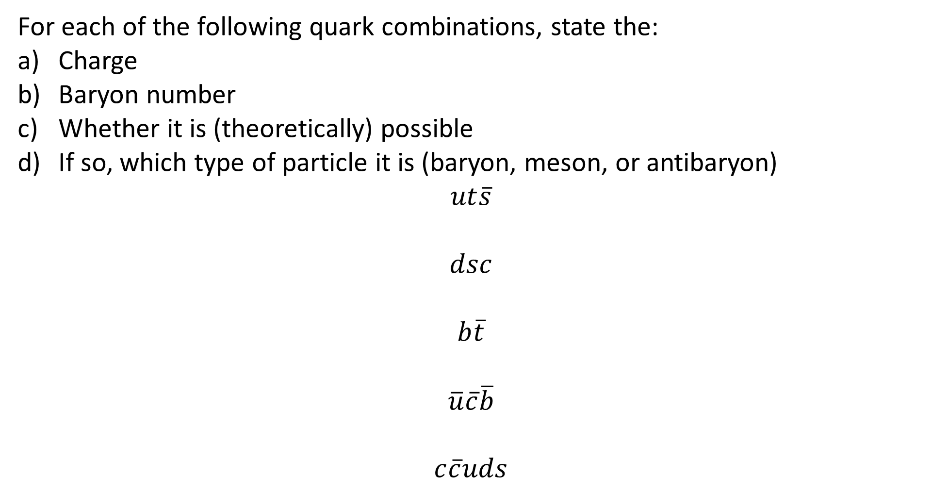
Example #2
For each of the following quark combinations, state the:
Charge
Baryon number
Whether it is (theoretically) possible
If so, which type of particle it is (baryon, meson, or antibaryon)
$$ut\overline{s}$$
$$dsc$$
$$b\overline{t}$$
$$\overline{u}\overline{c}\overline{b}$$
$$c\overline{c}uds$$
Notes:
(5/3)e, 1/3, not possible
0, 1, possible, baryon
-1e, 0, possible, meson
-1e, -1, possible, antibaryon
0, 1, possible, baryon (strictly speaking, baryons only need an odd number of quarks, not exactly 3; pentaquarks like this one have long been theorised but only [fleetingly] observed very recently)

Slide 7
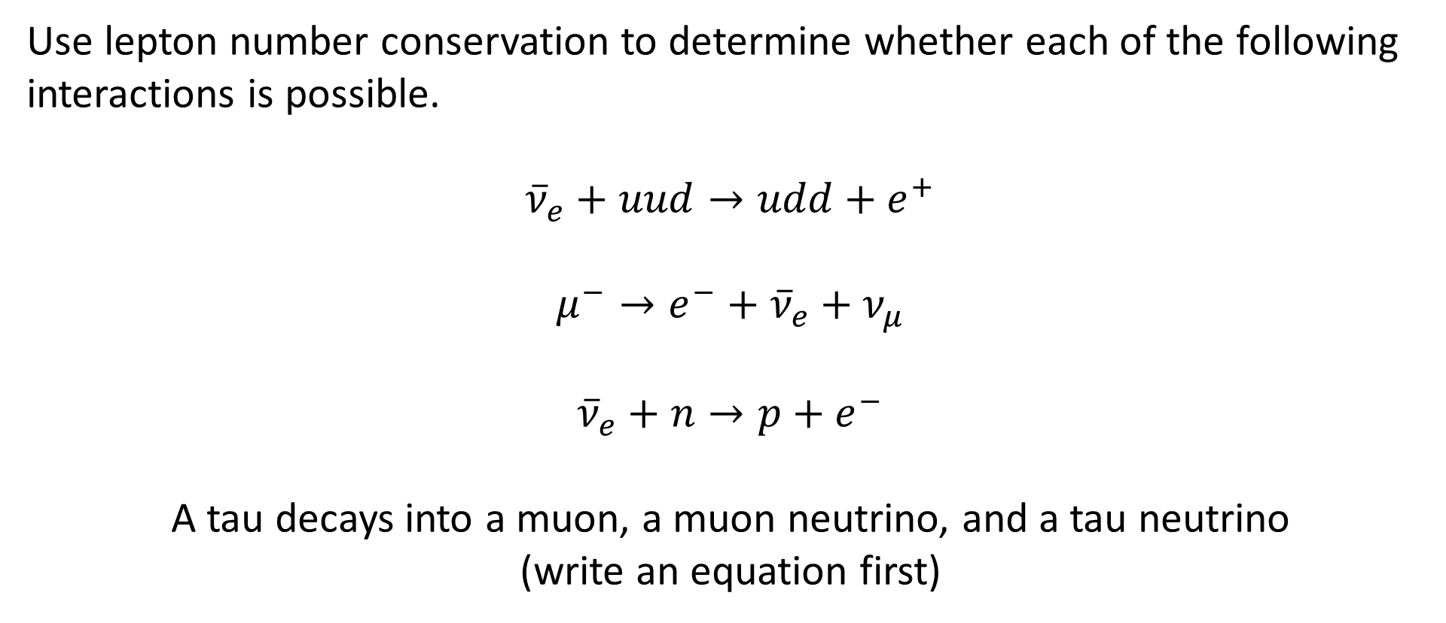
Example #3
Use lepton number conservation to determine whether each of the following interactions is possible.
$${\overline{ν}}_{e}+uud→udd+e^{+}$$
$$μ^{−}→e^{−}+{\overline{ν}}_{e}+ν_{μ}$$
$${\overline{ν}}_{e}+n→p+e^{−}$$
A tau decays into a muon, a muon neutrino, and a tau neutrino
(write an equation first)
Notes:
Yes
Yes
No (L_{e} not conserved)
No (L_{μ} not conserved)

Slide 8
Example #4
Use a combination of conservation laws to determine whether a proton can decay into a neutron, a positron, and an electron neutrino. Write an equation for the decay first.
Notes:
Yes (charge, baryon number, and lepton number conserved). This is β⁺ decay.

Slide 9
Example #5
A tau decays to form a tau neutrino, a down quark, and one other particle. Use a combination of conservation laws to identify the unknown particle, then write an equation for the decay.
Notes:
Antiup, anticharm, or antitop.

